Slide 1
Debugging Happiness

Slide 2
Bulgaria ranked #105 happiest nation
Notes:
Where do you think Bulgaria ranked in the annual rankings of the happiest nations on Earth?
105 out of 156. And this is a problem in my eyes, because I live this country. So I started to search for a solution.

Slide 3
What is happiness?
Notes:
After I while I got to the question: What is happiness?

Slide 4
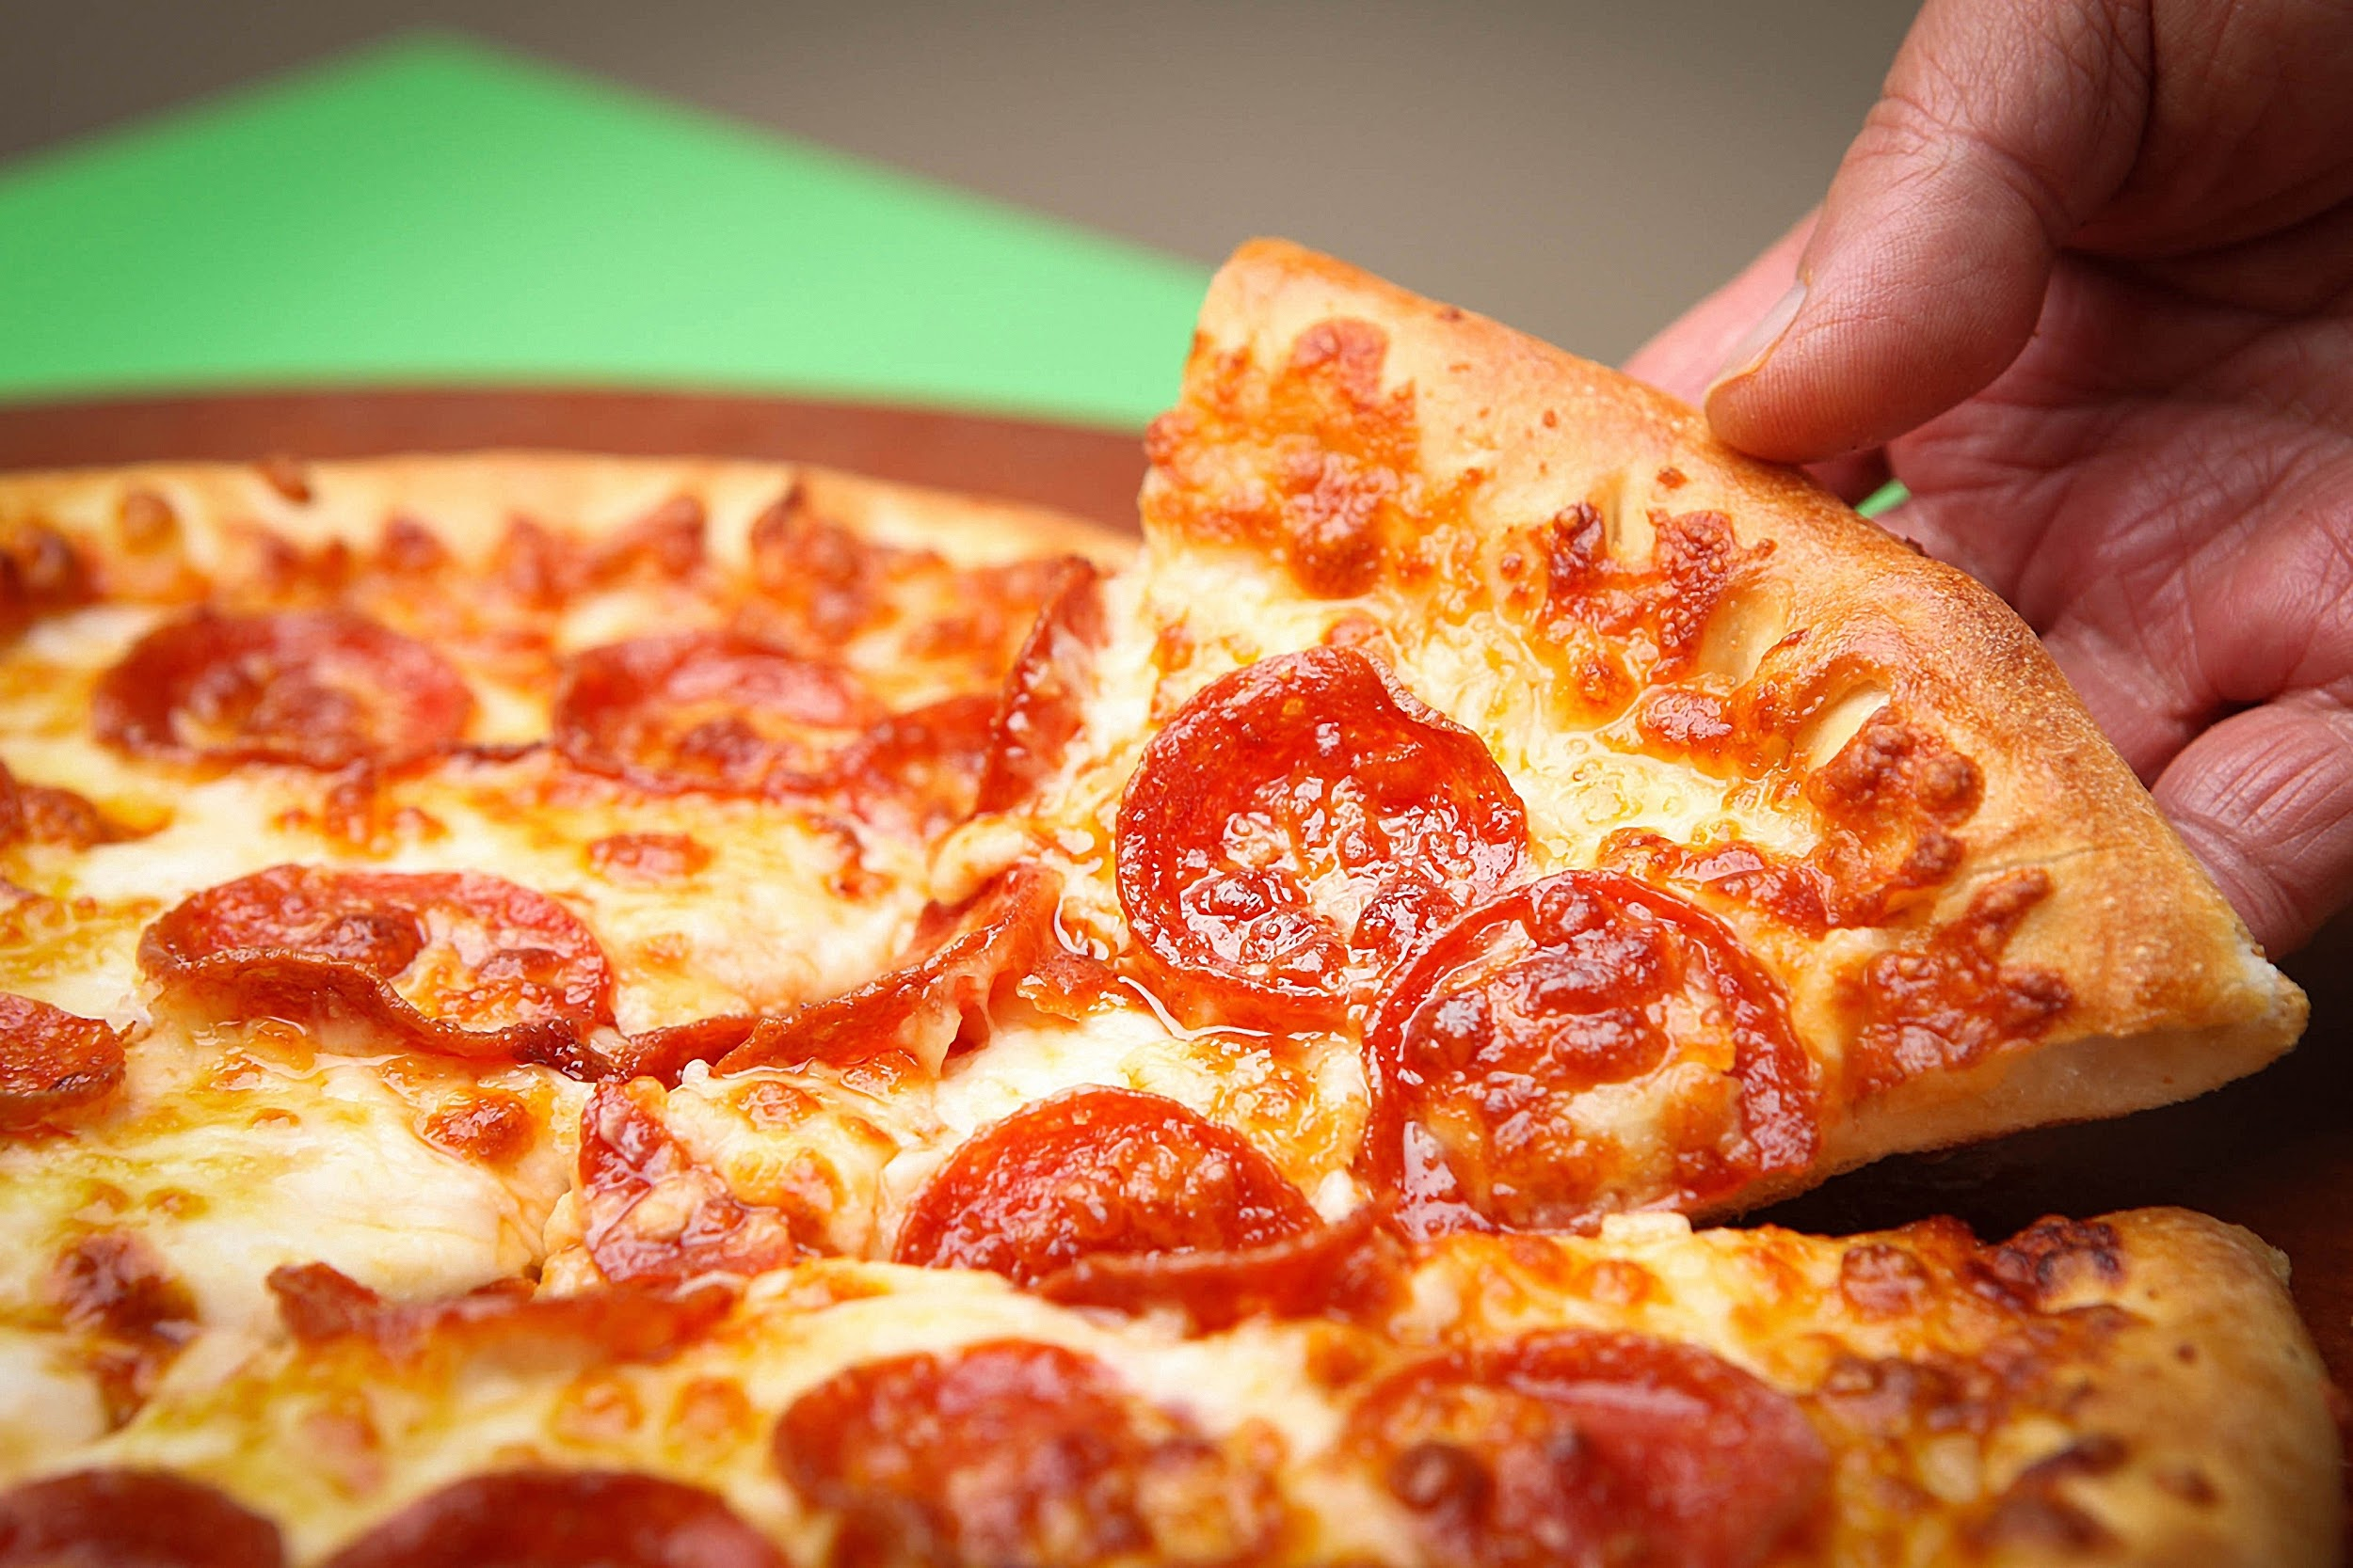
pizza
Notes:
The answer was easy - pizza

Slide 5
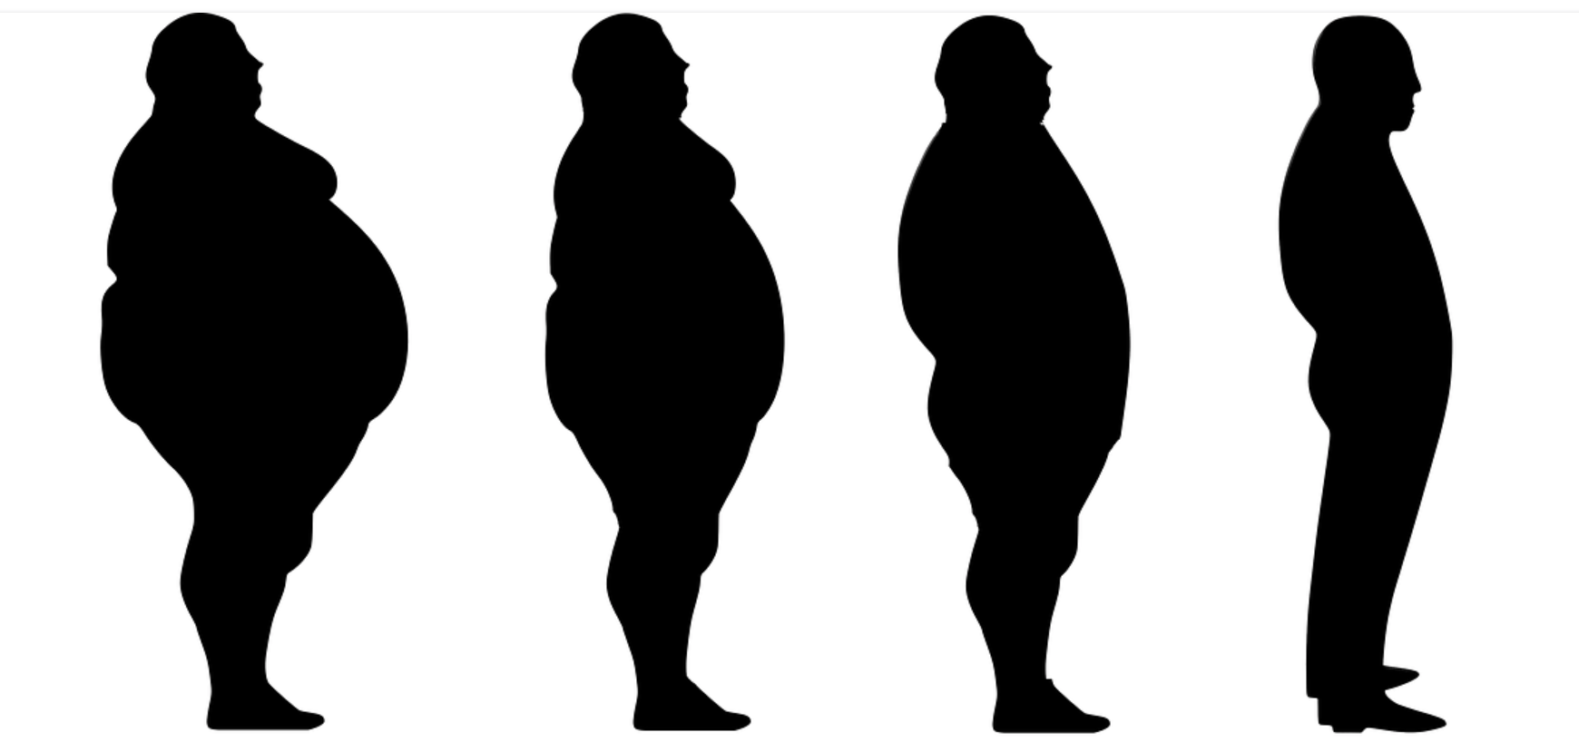
Notes:
But soon after that instead of happiness we feel regret

Slide 6

Notes:
Love to ride bike, but there are big vertical things which do not like to move and unfortunately I hit them sometimes.

Slide 7
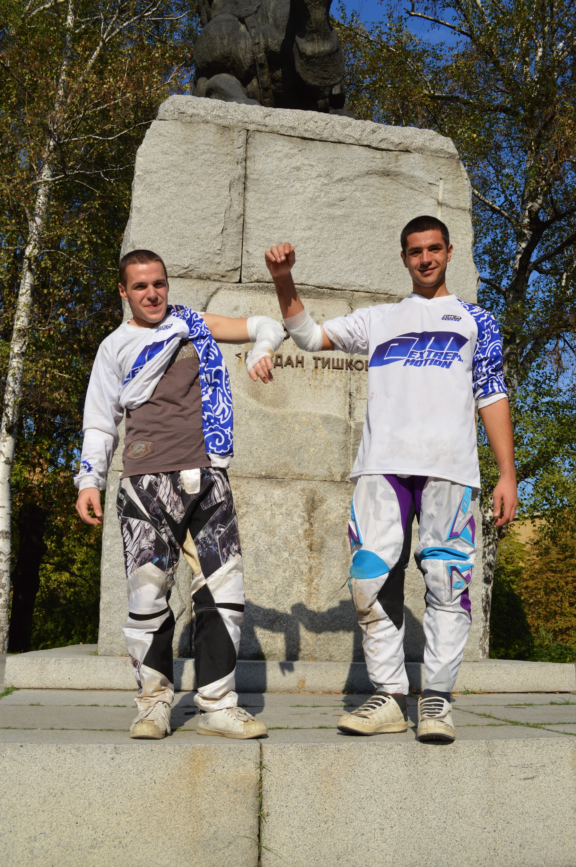
Notes:
And instead of happiness I feel pain and regret for the next few weeks.

Slide 8
Money = Happiness ?
Notes:
Can money be equal to happiness?

Slide 9
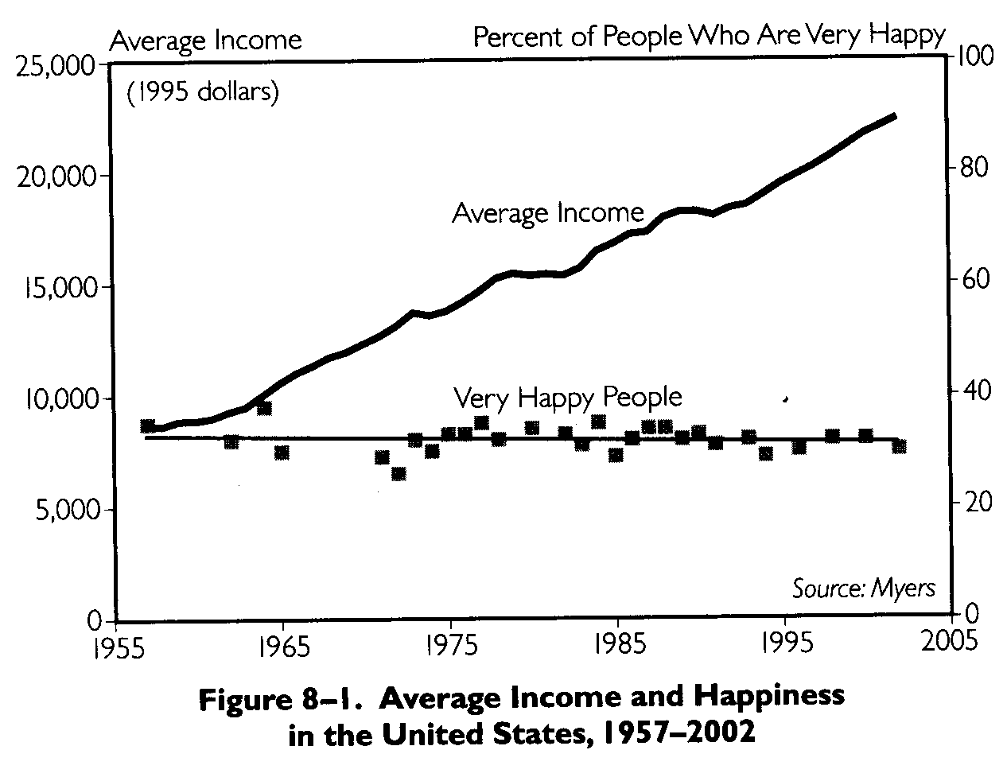
Notes:
Easterlin paradox. In the long term higher income is totally unrelated to happiness. This is true not only for America. The same research was made for 37 more countries in the world and the results were the same. China and S.Korea income per capita 2x in the last 2 decades, however the happiness levels slightly declined.

Slide 10
We always want more
Notes:
Because we always want more. We easily get used to all of the money, cars, houses, wealth and start to want more and more. Yes money and toys make us feel joy, but soon after that this feeling is gone.

Slide 11
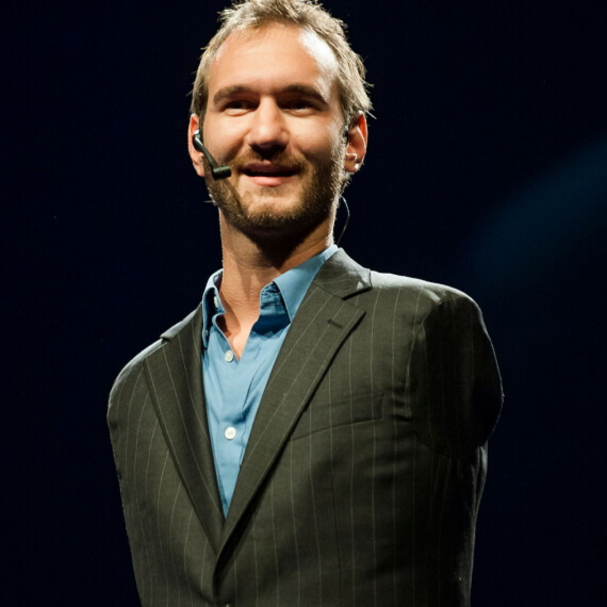
Notes:
How many of you know this guy?
This is Nick Vujicic. Australian tetra-amelia syndrome. One of if not the very best motivational speakers. He once said something that still resonates in my head.

Slide 12
Money, drugs, sex, alcohol, pornography, fame, fortune
Notes:
… Never satisfies. It’s never enough. Yes they can make us happy for a short period of time, but we will never be satisfied with their amount. And what happens when we want more than we have, instead of happiness we feel greed, depression and sadness.

Slide 13
Temporary joy != happiness.
Notes:
These things give us joy, but this is quite different than happiness.

Slide 14
What have I learned so far?
Notes:
But I am still debugging my problem and I wanted to know what truly happiness is. So what have i learned so far?

Slide 15
Nothing
Notes:
Well… nothing. I said a bunch of things that could possibly make you happy, but all of them are hollow. TED talks and articles than I could remember and I still had absolutely no idea what actually happiness is. So I had to change my approach. I turned up to the BULGARIAN philosophical holy grail. The source which has solved all my problems so far.

Slide 16
bg-mama.com
Notes:
There is a thread called “What is happiness for you?”

Slide 17
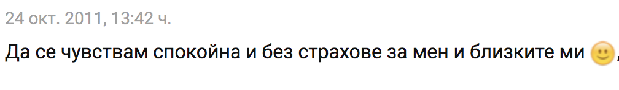
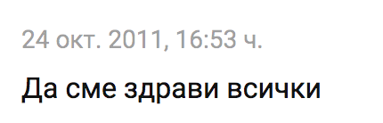
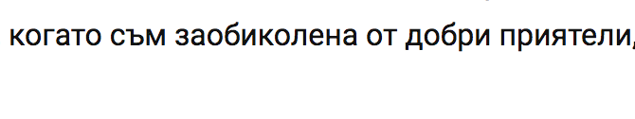

Slide 18
Happiness requires wisdom

Slide 19
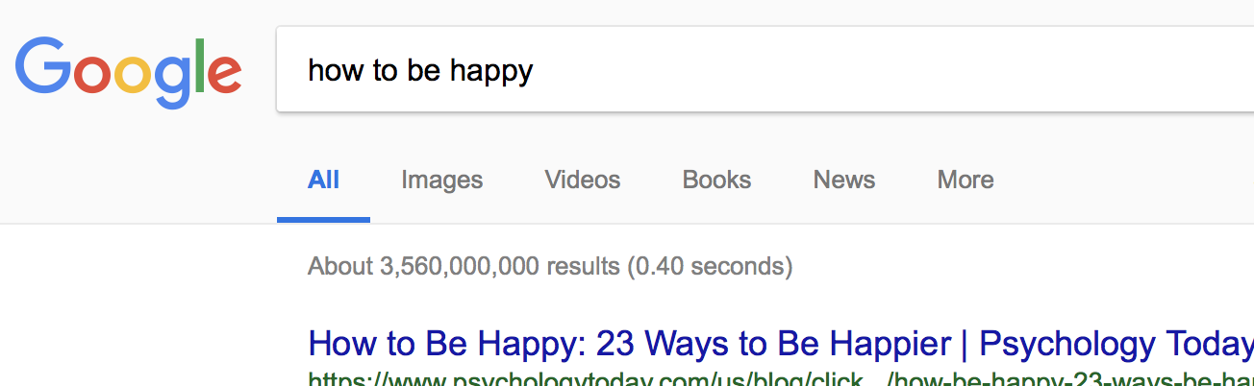
google.com

Slide 20
Clusters of data and criteria
What has been considered "true" for hundreds/thousands of years
Philosophical sources
Religious sources
Scientific data
Medicine, neuroscience, biochemistry, psychology
What elderly (65+) people say
scientific
timeless
elderly
this talk
Notes:
Unfortunately, research shows that cognitive functioning slows as people age. But speed isn’t everything.
cognition, reflection and compassion
greater sensitivity to fine-grained differences

Slide 21
Before we start
Q: Why do we and other animals have brains?
A: To produce adaptable and complex movements.
Notes:
You might reason that we have brains to perceive the world or to think.
And that would be wrong.
Muscle contraction and sweating

Slide 22
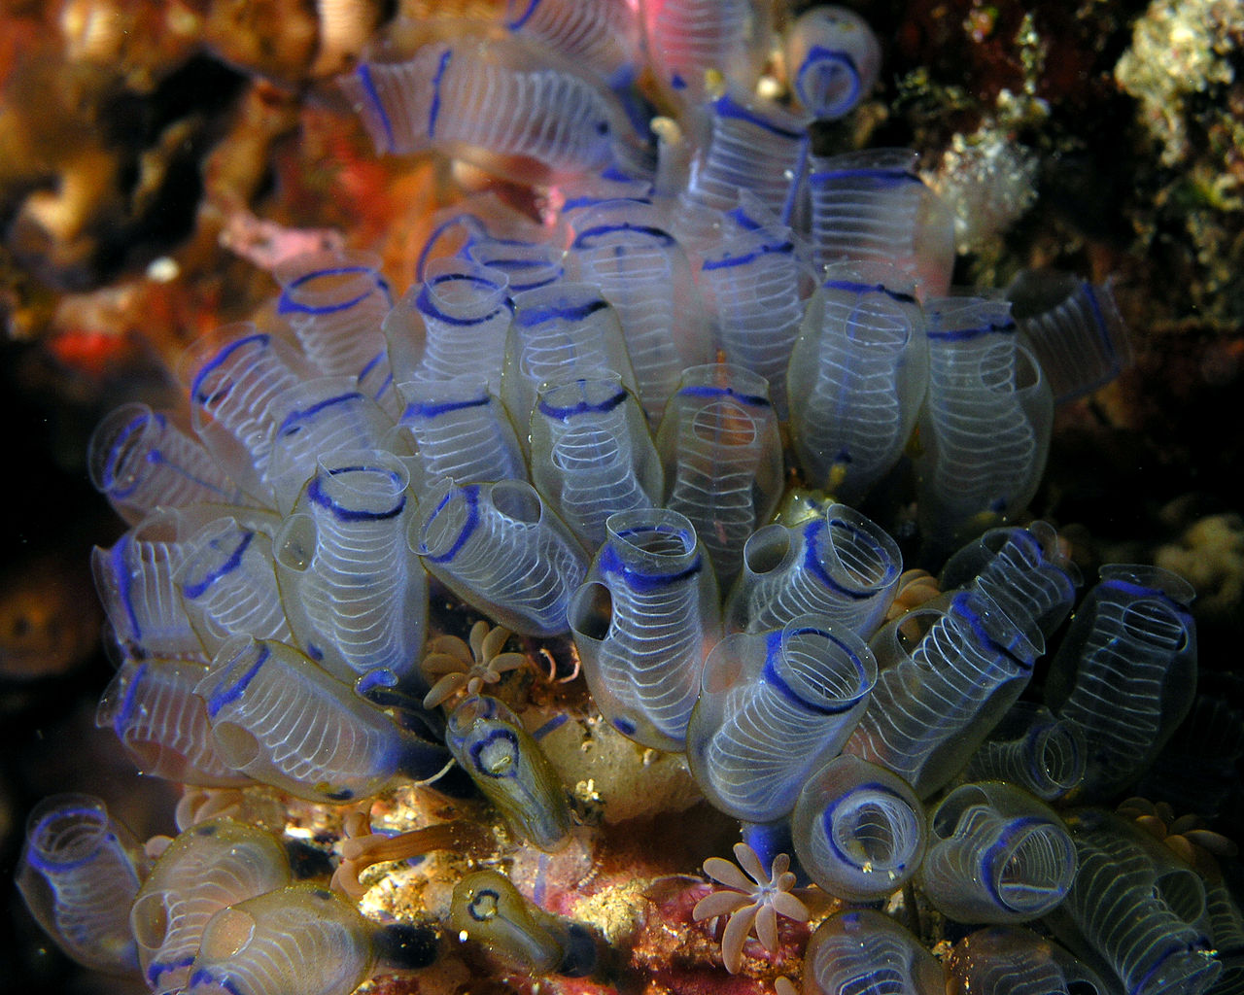
Notes:
Trees and grass.
sea squirt
has a nervous system, swims around in the ocean in its juvenile life. And at some point of its life, it implants on a rock. And the first thing it does in implanting on that rock, which it never leaves, is to digest its own brain and nervous system for food. So once you don't need to move, you don't need the luxury of that brain.

Slide 23
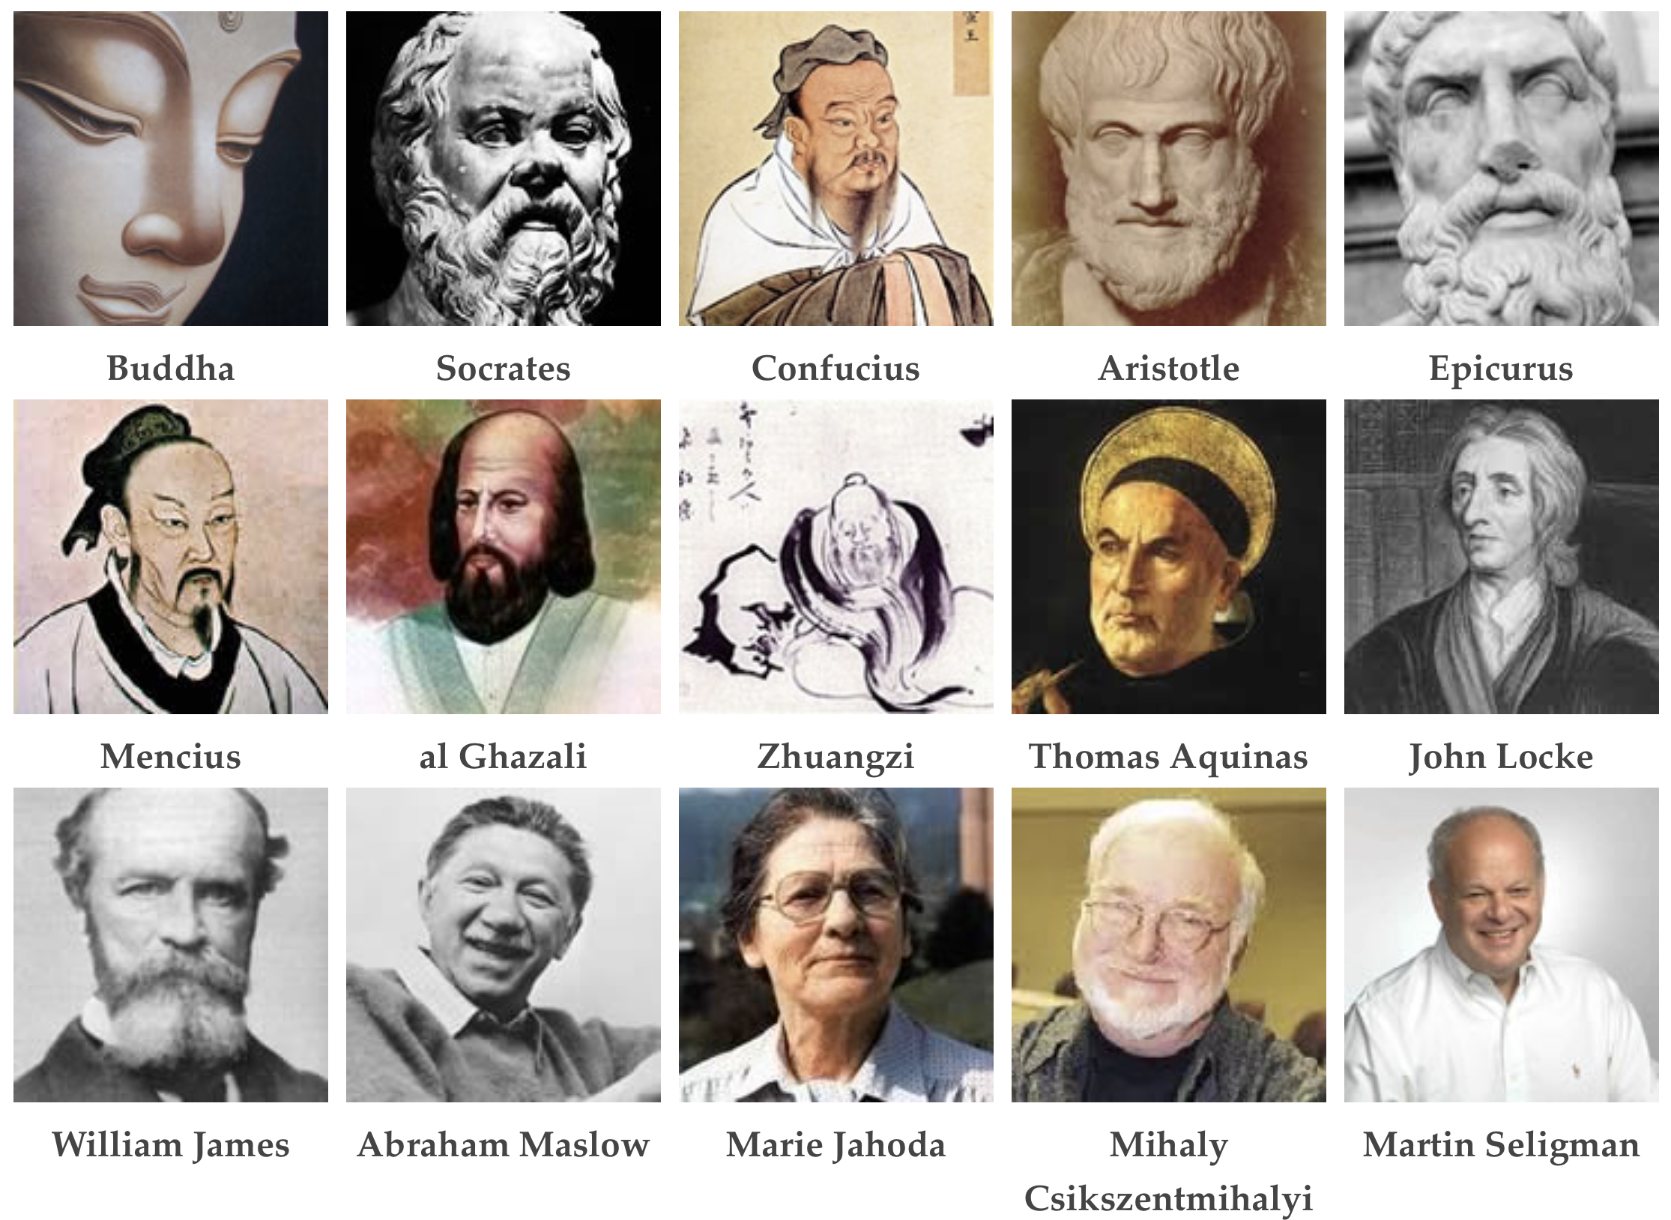
What is happiness
Notes:
Pursuit of happiness began in China, India and Greece nearly 2,500 years ago with Confucius, Buddha, Socrates, and Aristotle.
And we can find remarkable similarities between the insights of these thinkers and the modern “Science of Happiness.”

Slide 24
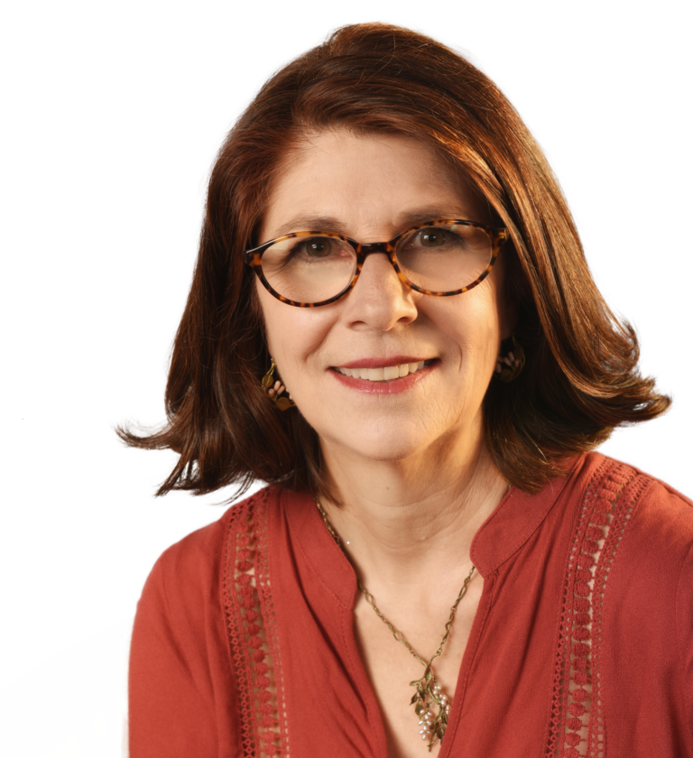
What happens in our body
Physically happiness is created by four different brain chemicals; endorphin, dopamine, oxytocin, and serotonin.
Loretta Breuning
scientific
timeless
Notes:
Absolutely aligned with a recent Bulgarian philosopher who said "Two parts"
Aspect
Unfortunately - for me this is too abstract ⇒ not actionable.
(L. G. Breuning, Psychology today, 2011) - sounds actionable. If we could affect these we'd be happier.

Slide 25
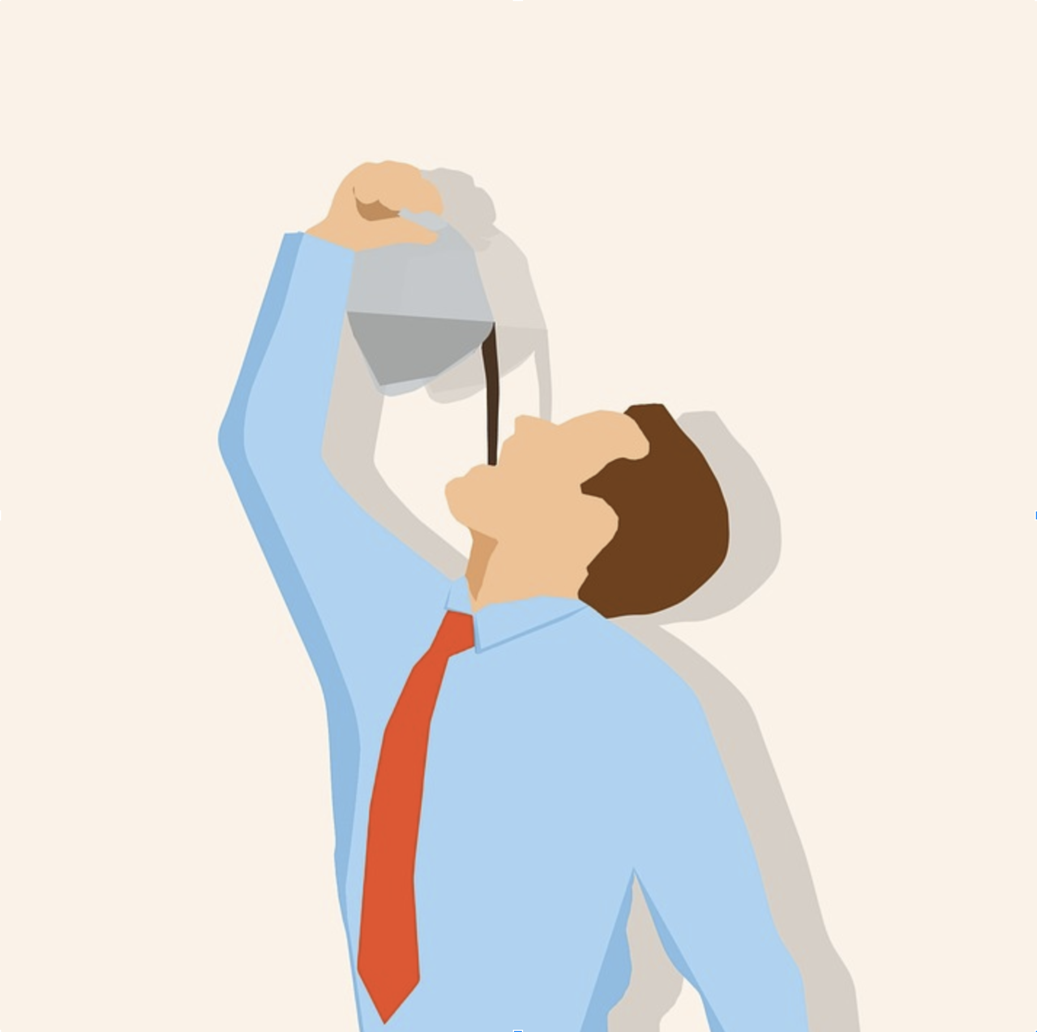
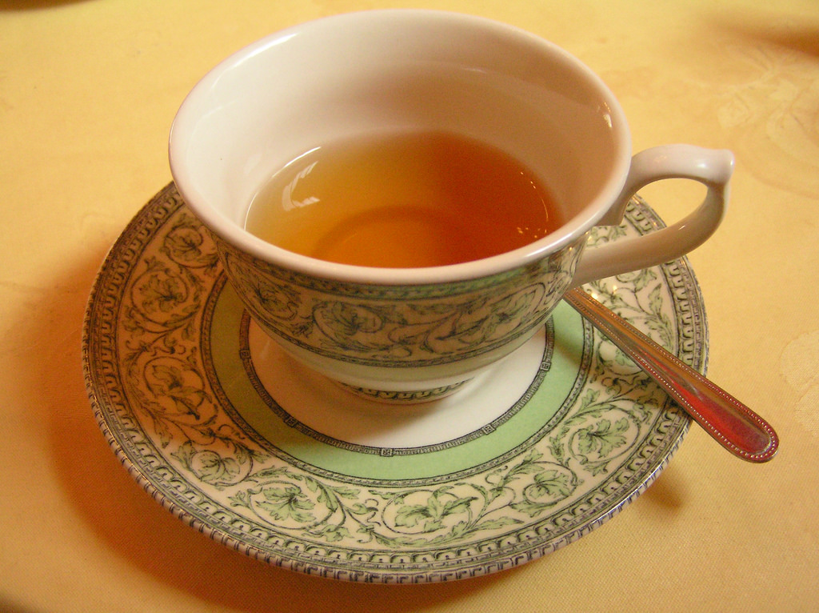
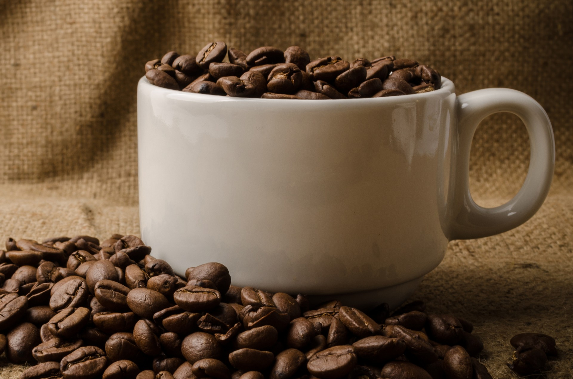
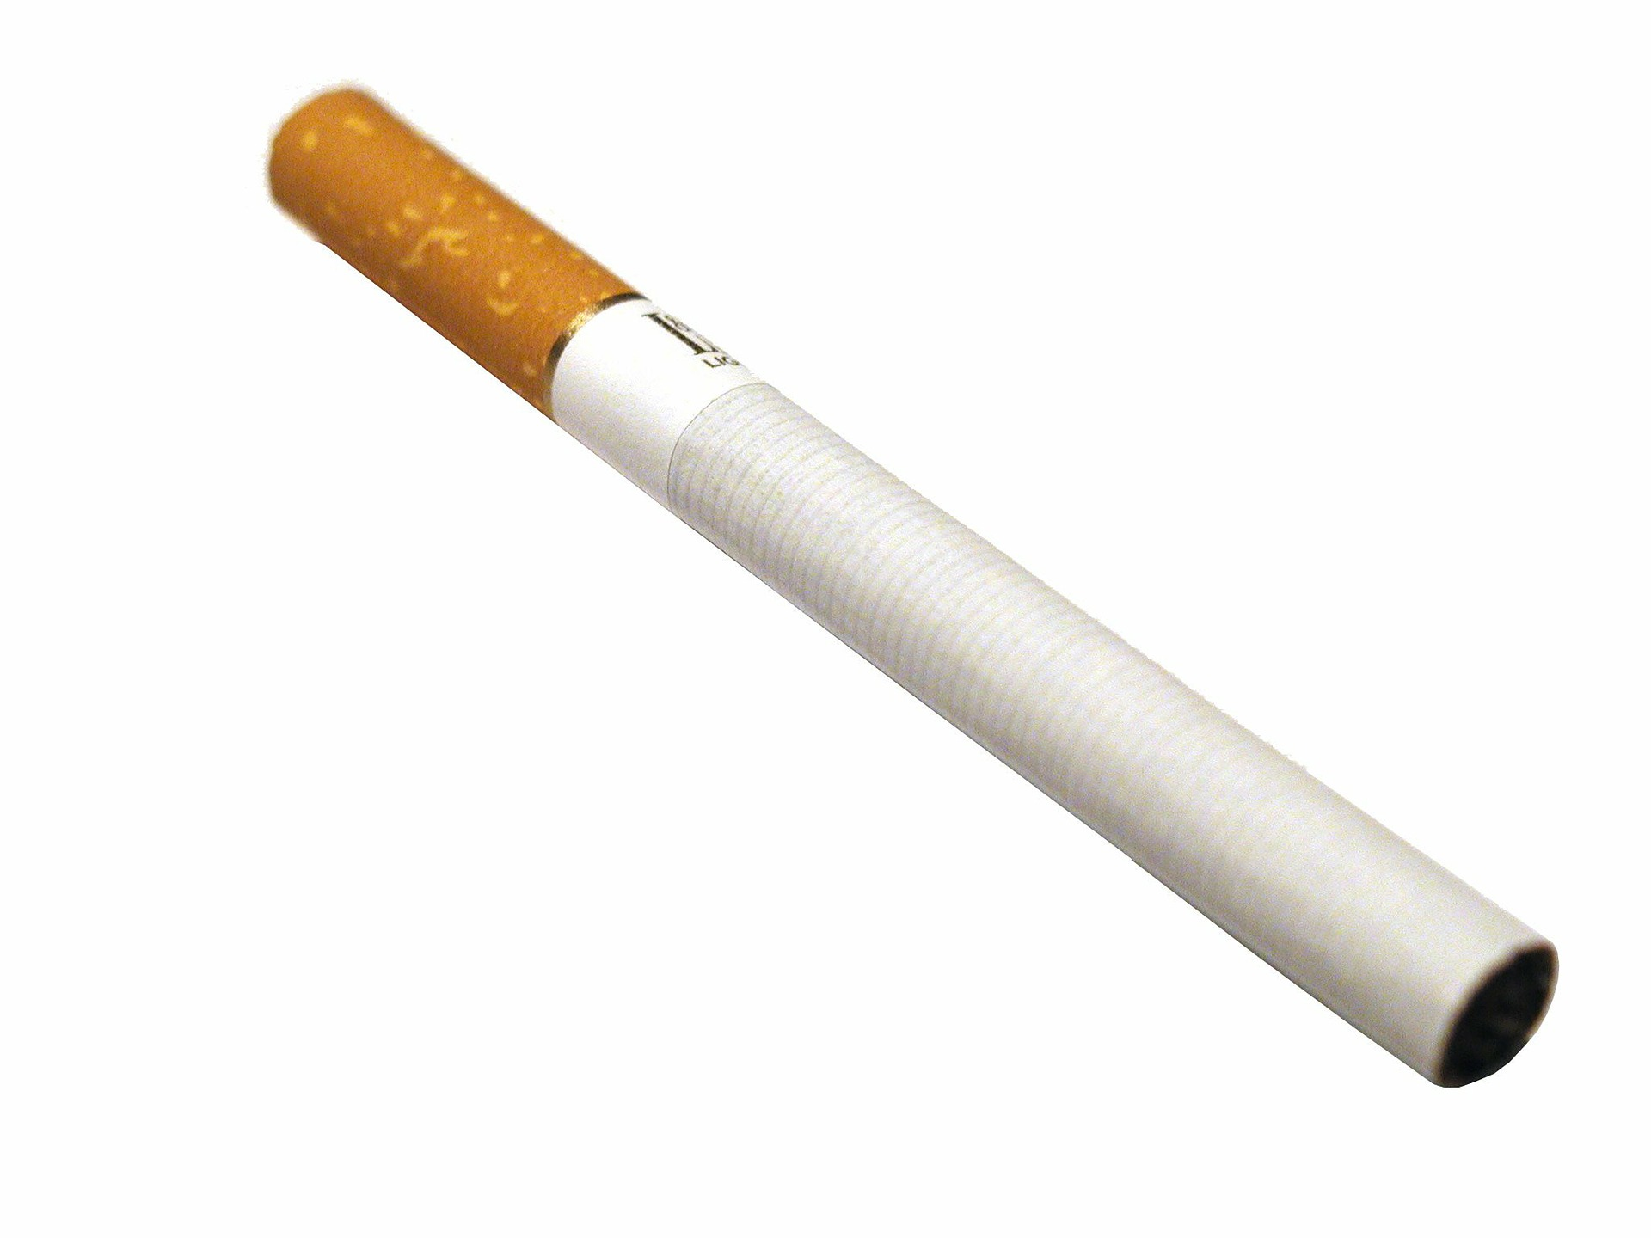
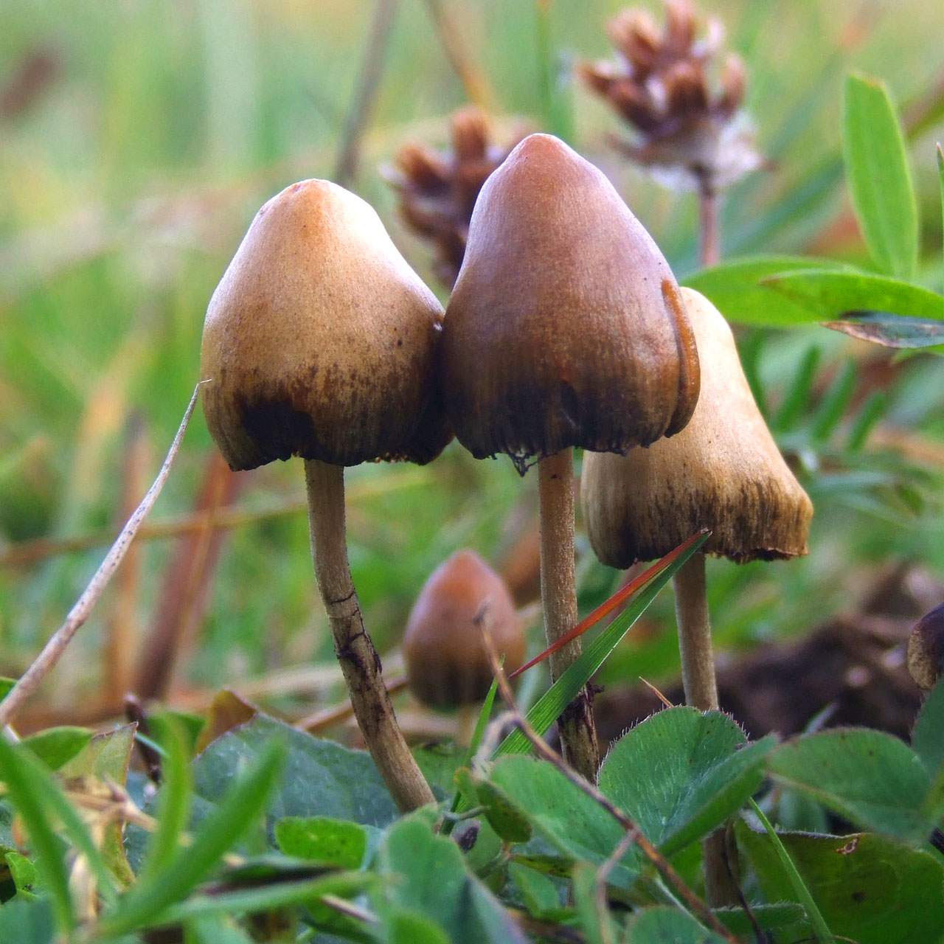
Notes:
Inhale a helium balloon
Drinking pəˈtæsiəm ˈsaɪənaɪd would cause very permanent change.
Some things change you more, some change you less.

Slide 26
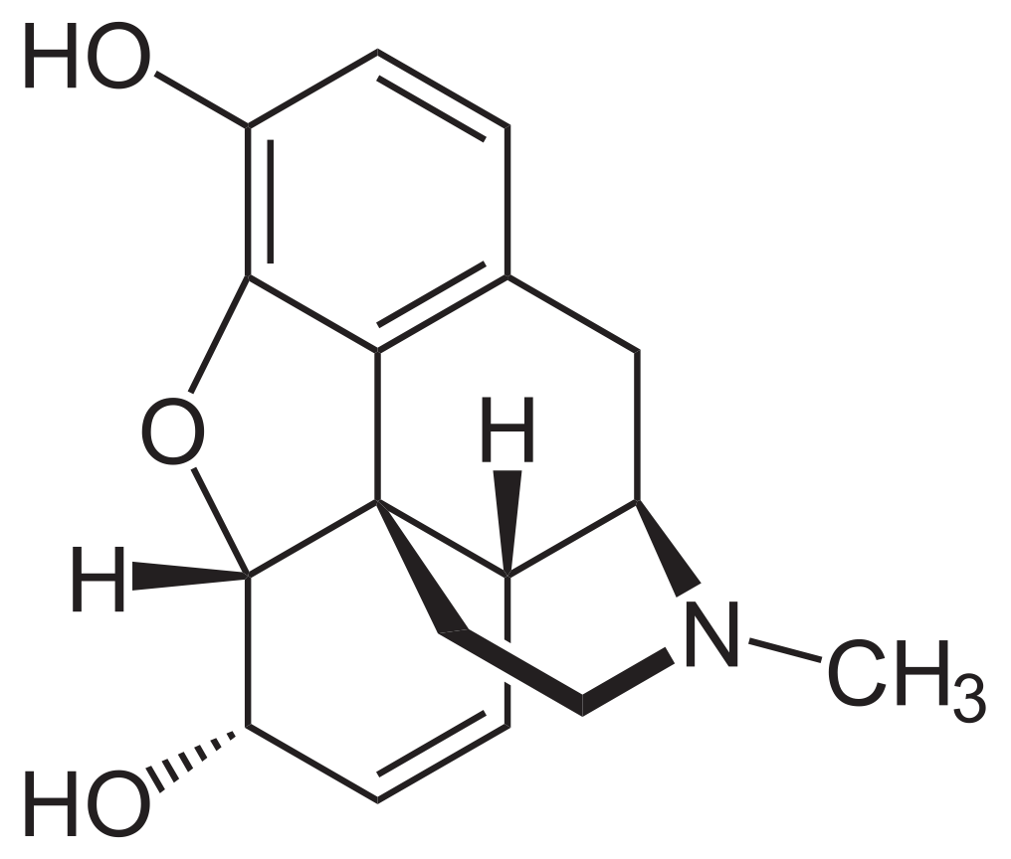


Endorphins
Endorphins (contracted from "endogenous morphine") goal is to suppress body pain. When you're tired you keep going.
Tip: Exercise; don’t overdo it.
Notes:
One of the definitions of “happiness” is “not having problems”
enˈdäjənəs
Activate opioid receptors in the body, suppressing body pain.
Opioids are the chemicals that suppress pain and increase pleasure – opioids have a general calming and anti-depressing effect.
natural, organic, vegan, gluten-free painkiller
allows to keep going
For example when you are hunting, or are being hunted.

Slide 27
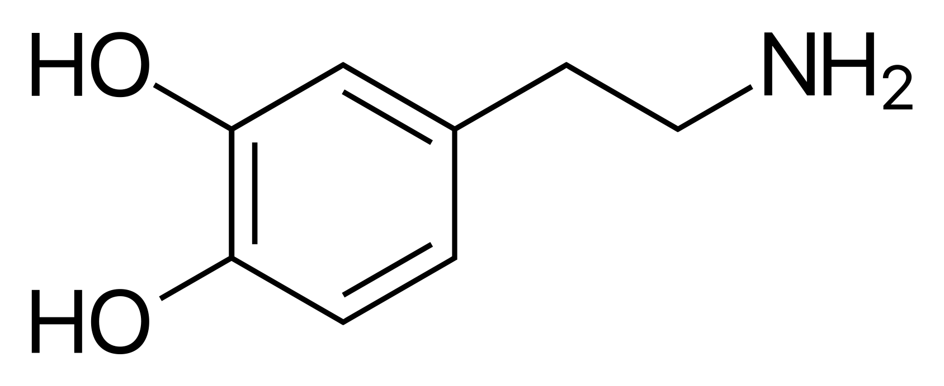
Dopamine
Dopamine - the feeling when you accomplish something you've set to accomplish *
Seeing a target gets you a small dose of dopamine. Getting closer to the target - dopamine again.
closing a Jira issue: dopamine
when you eat: dopamine
Set goals, break them down into smaller ones. (Agile vs Waterfall)
Celebrate success, pat yourself on the back
highly addictive* = dangerous (alcohol, nicotine, gambling, smartphone)
Notes:
* Plays major role in reward and pleasure centers.
When a person is ABOUT to experience pleasure, dopamine is released in the brain.
Dopamine’s role here is NOT to make you feel good. This is done by opioids.
Dopamine’s role is то help you recognize an activity and generate wanting for it in the future.
Our brains are wired to ensure that we will repeat life-sustaining activities by associating those activities with pleasure.
The dose makes the poison
Take a sip
Alex and Jim: Celebrate success

Slide 28
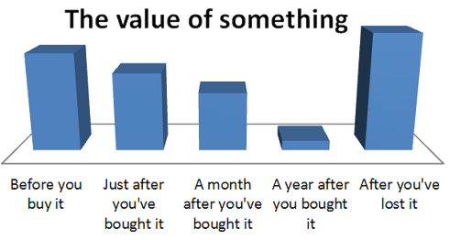
The Power of Gratitude
Notes:
Could be the new iPhone, your girlfriend, salary
Expectation and reward
Tim Ferris “5 minute journal”.
Diary writing can be ˌtherəˈpyütik, productive and creative

Slide 29
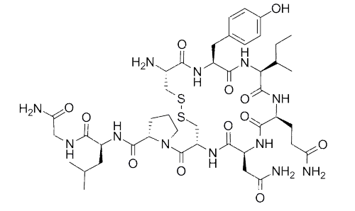

Oxytocin
Notes:
a.k.a the bonding hormone
Serotonin and Dopamine have also their role in bonding and social activities
STUDIES: Bonding and socializing have effect on life expectancy and happiness.
Humans are by nature social beings.

Slide 30
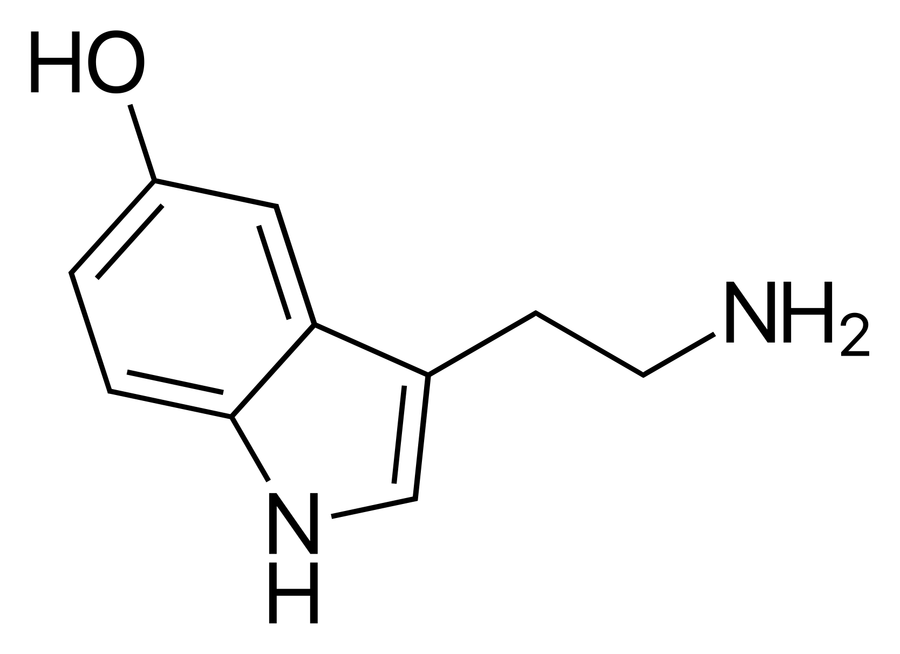
Serotonin
5-Hydroxytryptamine a.k.a. Serotonin.
L-tryptophan is influenced by rhythm.
Rhythm:
Activity
Exercise (not too much, you choose to/not when feel forced, don't skip)
Aerobic, Yoga, HIIT
Bright light (3000 lux)
Sunlight/vitamin D3
Massage
Rest
Diet
Tryptophan is present in most protein-based foods
Pumpkin & squash seeds, tofu
Meat and dairy also contain amino acids that obstruct tryptophan absorption
Smoothies (veggie over fruit ones because of fibers / Glycemic index)
Notes:
L-tryptophan deficiency = low Serotonin and low Niacin /ˈnaɪəsɪn/ (nicotinic acid, vitamin B3 - for digestive system, skin and nervous system)
- Recognizing that you are choosing to exercise changes it's neurochemical effect
The biggest problem with exercise is that when people don't feel like doing it, they don't do it. But sometimes the reason they don't feel like doing it is because their serotonin activity is low, and they'd rather pig out on chips or watch TV.
Tryptophan is present in most protein-based foods
Glycemic index:
- veggies > fruits
- smoothies > juices
Fibers:
- soluble – forms a gel, slows absorption of sugar
- insoluble – promotes the movement of material through your digestive system

Slide 31

Vitamin D3: too much detail
Facts:
Cholecalciferol (C₂₇H₄₄O, a.k.a Vitamin D3) is an oil-soluble steroid hormone formed when UVB radiation hits the surface of the skin and converts 7-Dehydrocholesterol (a cholesterol derivative) to Vitamin D3.
It takes ~48 hours for D3 to penetrate from the surface of the skin to the bloodstream.
Half-life of D3 in bloodstream is 1-6 weeks (avg. 2 weeks, depends on initial level, and source)
Window glass filters UVB, and does not filter UVA radiation.
UVB wavelength must be between 270 and 300 nm, with peak D3 synthesis between 295 and 297 nm.
UVA (315 to 400 nm wavelength) destroys D3, causes the tan, is one of the main skin-aging factors, is one of the main causes of skin cancer, etc.
UVB (280 to 315 nm wavelength) does not stimulate melanin pigmentation much (melanin peak is at 335 nm) => does not result in tan
Sun in its peak (around 12h at noon) has highest UVB/UVA ratio. Early morning and evening Sun rays travel too long through the atmosphere, which filters UVB.
Corollary:
Soap-washing your Sun-exposed skin for ~48 hours washes D3 away before it reaches your blood
Notes:
Needs UVB
Window glass filters UVB
Sun at its peek (12h at noon) has highest UVB
Washing

Slide 32
我不明白
Notes:
Thanks, Rumen very interesting stuff indeed. Now we know what is happiness actually it is dopamine oxytocine… But I do not understand any of this I am not very good with chemistry. To stop here

Slide 33
scientific
timeless
elderly

Slide 34
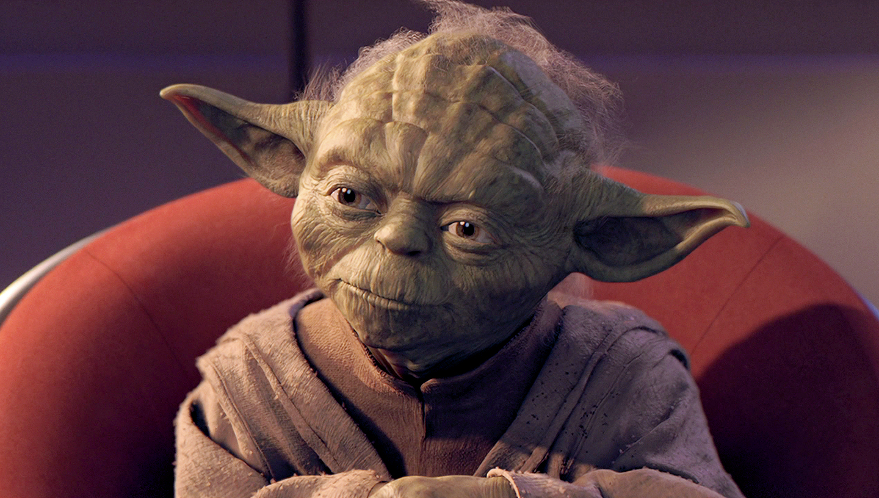
Notes:
Usually when you ask elderly people “What happiness is?” They will reply that it is to be healthy and to have no major problems. The second one seems obvious, because when you have a majer problem you cannot stop thinking about it…. Broken build cannot enjoy anything too much worries news tasks duties etc.

Slide 35
What is health?

Slide 36
19th Century
Freedom from disease, pain, or defect.

Slide 37
1946
A state of complete physical, mental and social well-being.
Notes:
Aristotel Social – Values match the ones to the people around you. So we have to dig deeper around what are values

Slide 38
scientific
timeless
elderly
Notes:
This is where our scientific and timeless sources meet.
On next slides we’ll see that biochemistry, philosophy, religion and psychology are saying the same things.
We only need to understand the term ”values”

Slide 39
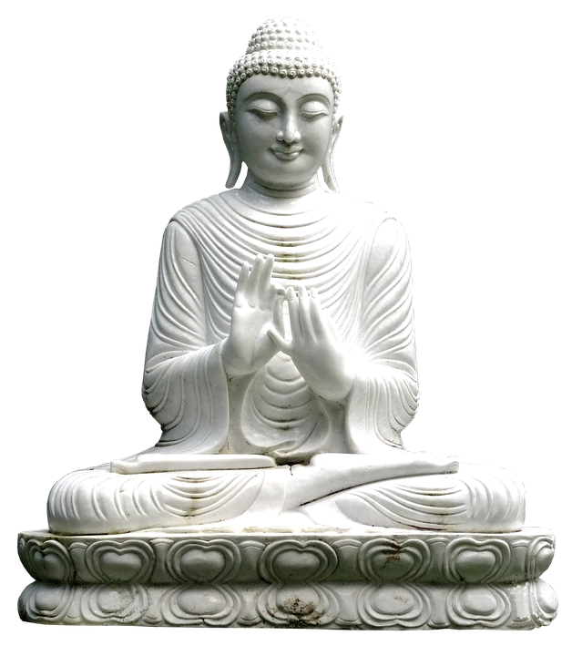
External vs. internal happiness
vs.
Notes:
External values never satisfy, they are never enough.

Slide 40
Values
Religion
Christianity – 10 commandments
Buddhists – 8-fold path/5 precepts
Philosophy
Plato's universal values: Beauty, Goodness, Truth
Psychology
Advices on how to apply values
Notes:
8-fold path = Right:
Wisdom – view, intention
Concentration – meditation, mindfulness, effort
Conduct – speech, action, livelihood /ˈlaivlēˌho͝od/
5 /ˈprēˌsept/s = abstain from killing living beings, stealing, sexual misconduct, lying and intoxication
The bliss of being human and permanent happiness is based on humans’ realization of the highest possible values
"Don't steal", so says the law, so it contributes to my happiness.

Slide 41
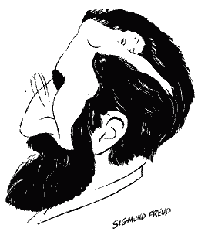
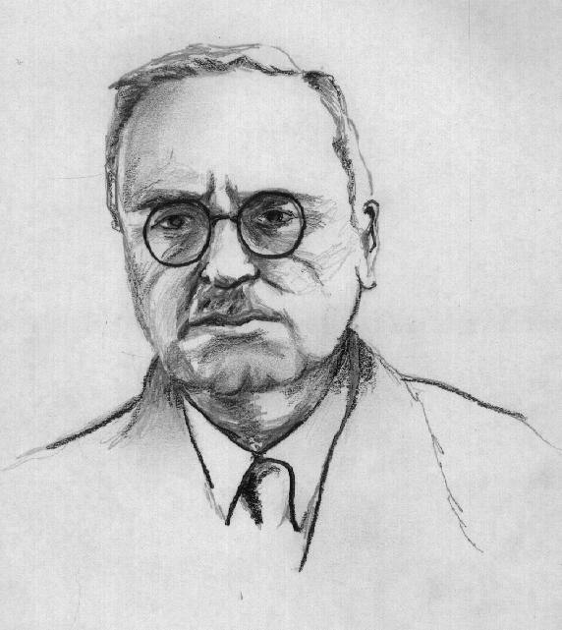
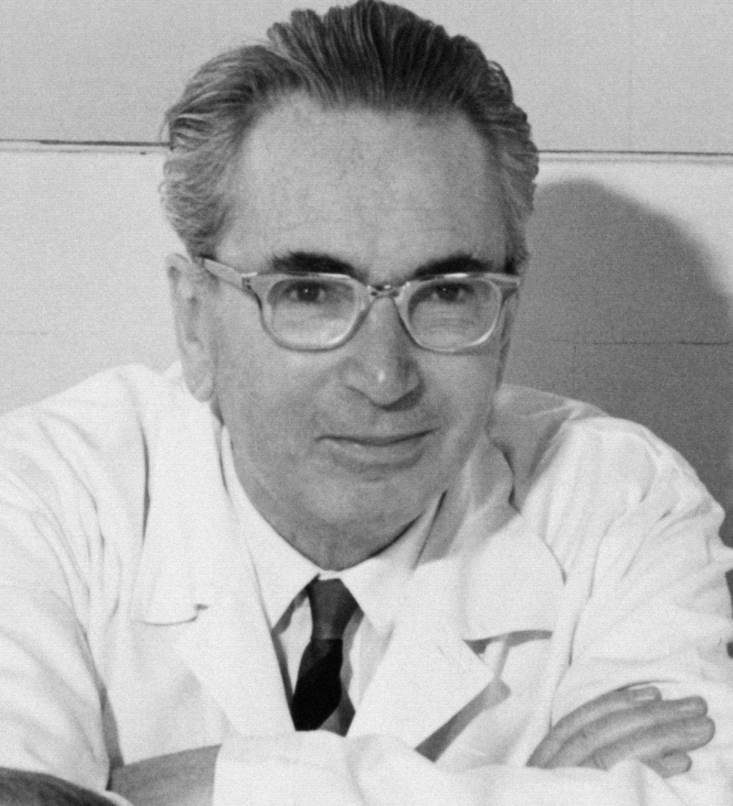
The three Viennese schools of psychology
Sigmund Freud (1856-1939)
Alfred Adler (1870-1937)
Victor Frankl (1905-1997)
Notes:
V.Frankl:
Permanent happiness is when you act according to your values

Slide 42

Values
Options to apply your values:
Experiential
On demand
Very easy, one-off effort
Immediate, short-lasting ROI
(smell a rose, enjoy a view, hear a good song, etc.)
Behavioral
On demand
Continuous effort
Long-lasting ROI
Attitudinal
Situational
High risk
High reward. Reward lasting forever
Notes:
Fulfillment in putting one's soul into something, e.g. enjoyment of arts and nature:
Making values become real through creative activity:
Steadfast bearing of the blows of fate:

Slide 43
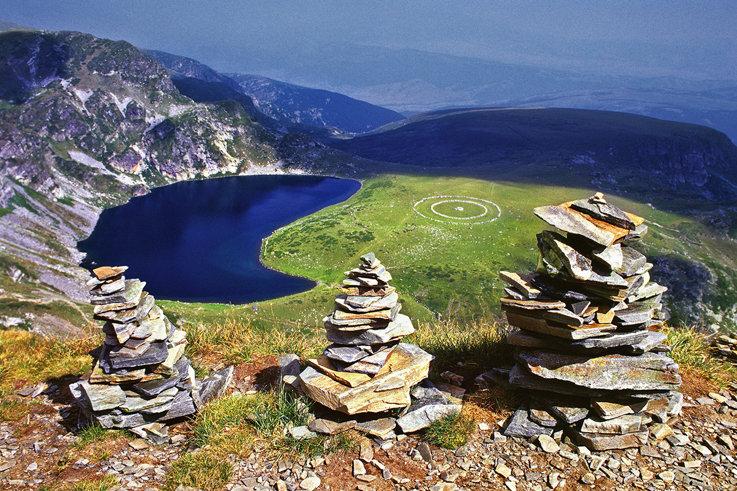
Notes:
When I act according to my values I’m happy.
When we show bravery, courage, dignity – we are happy.
enjoyment of arts or nature (connect to Beauty) - fulfillment in putting one's soul into something
making values become real through creative activity
– connect to Beauty.
fulfillment in putting one's soul into something (e.g. enjoyment of arts or nature)
- making values become real through creative activity
Love / Joy: Invest those 3 seconds of your life into piece of happiness. ROI guaranteed.
Work: You know that biochemically this makes you happy
Just overcome the knowledge-action gap. Because U R a Google search away from any decision.
Works best when you get things done for other people
Withstand, endure, to last, to persist, continue
Situational
/ikˌspirēˈen(t)SH(ə)l/ – Beauty
Behavioral - Plato's Goodness
/ˌadəˈt(y)o͞od(ə)n(ə)l/ - Truth

Slide 44
Values
Options to experience your values:
Experiential
On demand
Very easy, one-off effort
Immediate, short-lasting ROI
(smell a rose, enjoy a view, hear a good song, etc.)
Behavioral
On demand
Continuous effort
Long-lasting ROI
(work, create something, do something, leave a trail; the opposite of procrastination)
Attitudinal
Situational
High risk
High reward. Reward lasting forever
Notes:
Fulfillment in putting one's soul into something, e.g. enjoyment of arts and nature:
Making values become real through creative activity:
Steadfast bearing of the blows of fate:

Slide 45
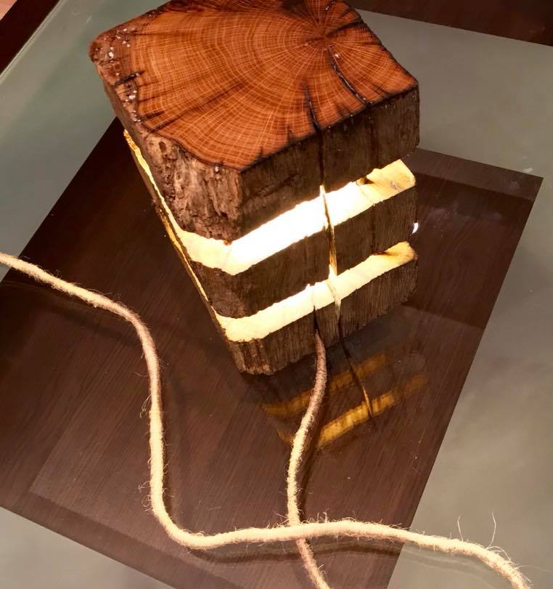
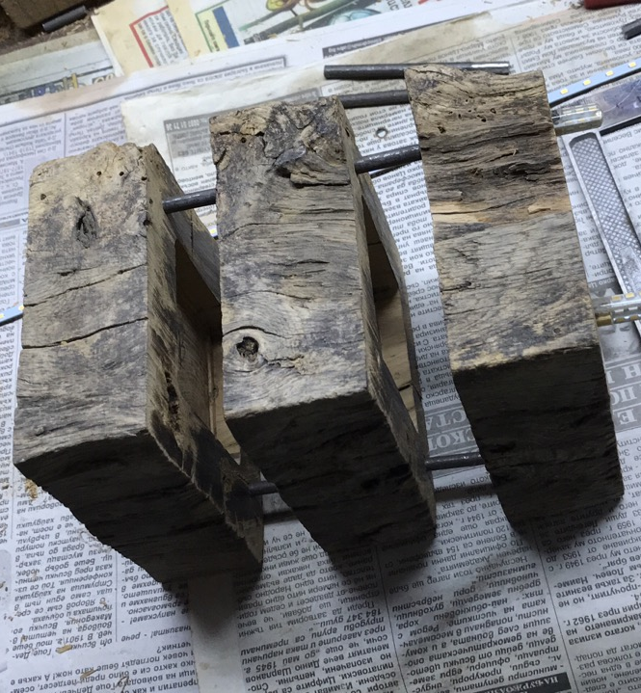
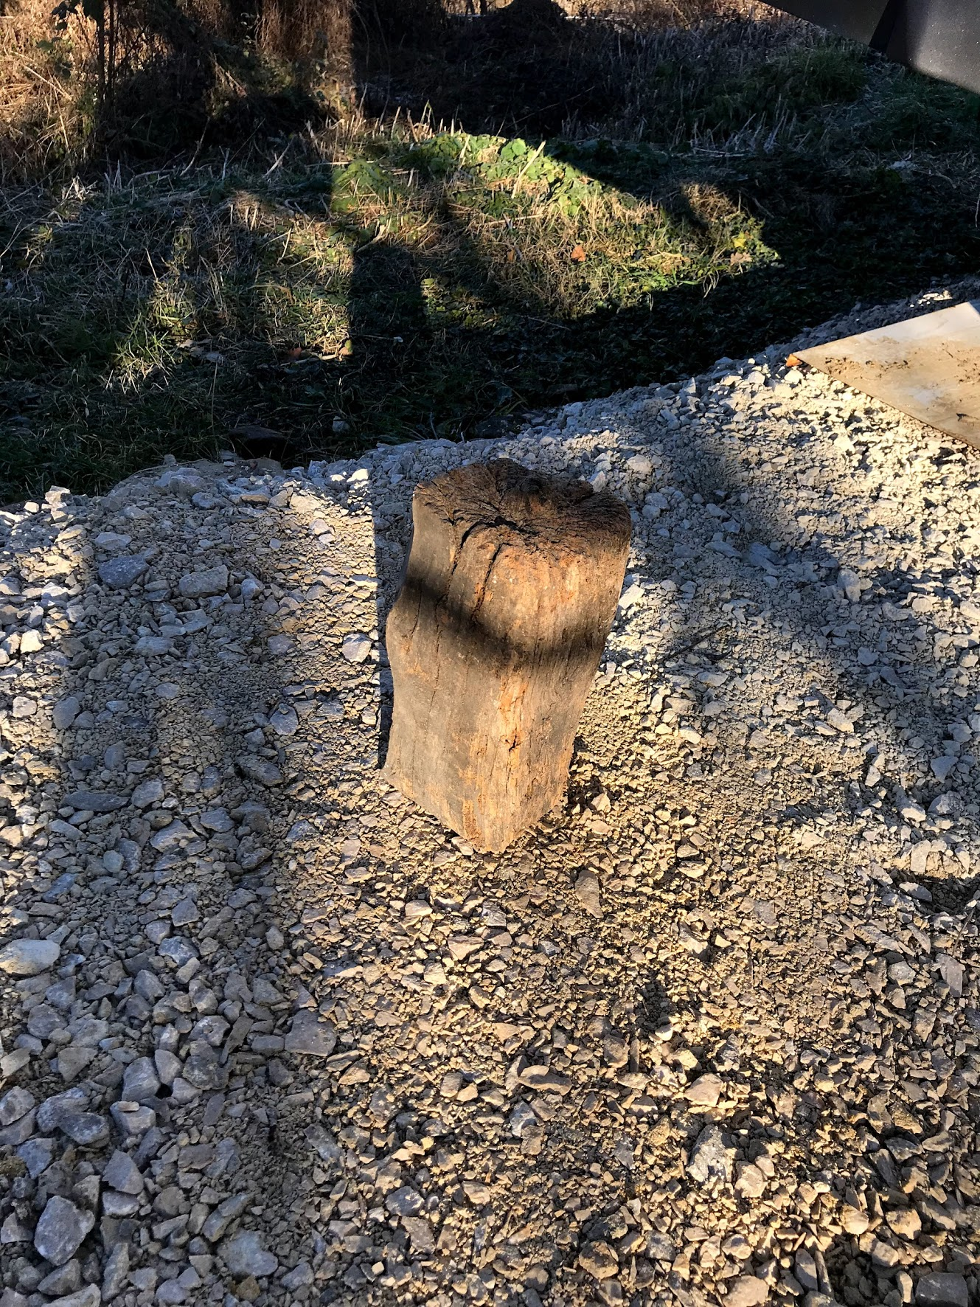
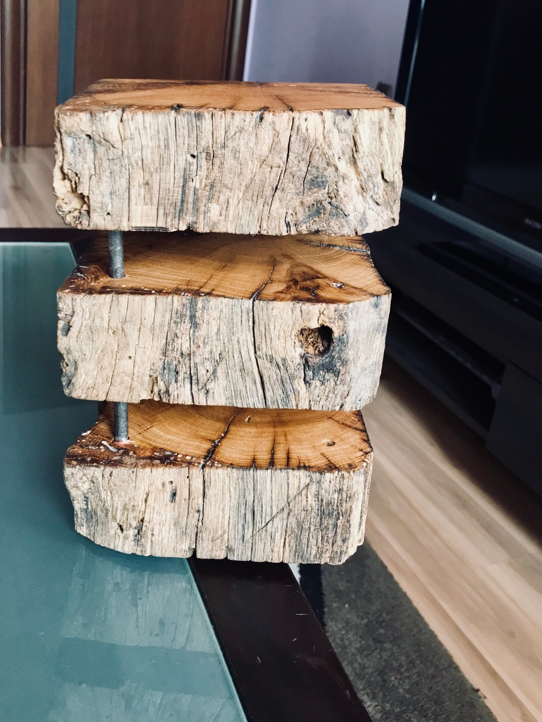

Slide 46
Values
Options to experience your values:
Experiential
On demand
Very easy, one-off effort
Immediate, short-lasting ROI
(smell a rose, enjoy a view, hear a good song, etc.)
Behavioral
On demand
Continuous effort
Long-lasting ROI
(work, create something, do something, leave a trail; the opposite of procrastination)
Attitudinal
Situational
High risk
High reward. Reward lasting forever
(show courage, bravery, dignity)
Notes:
Fulfillment in putting one's soul into something, e.g. enjoyment of arts and nature:
Making values become real through creative activity:
Steadfast bearing of the blows of fate:

Slide 48
Painter
Architect
Singer
Mathematician
Dancer
Figure skater
Artist
Physicist
Software Developer

Slide 49
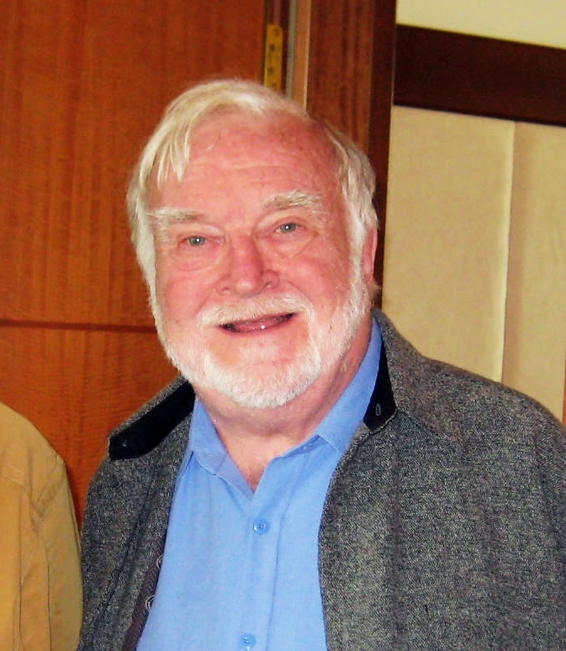
Notes:
How many of you know this guy? I actually can not pronounce his name, so I will let this little budy to say it

Slide 50
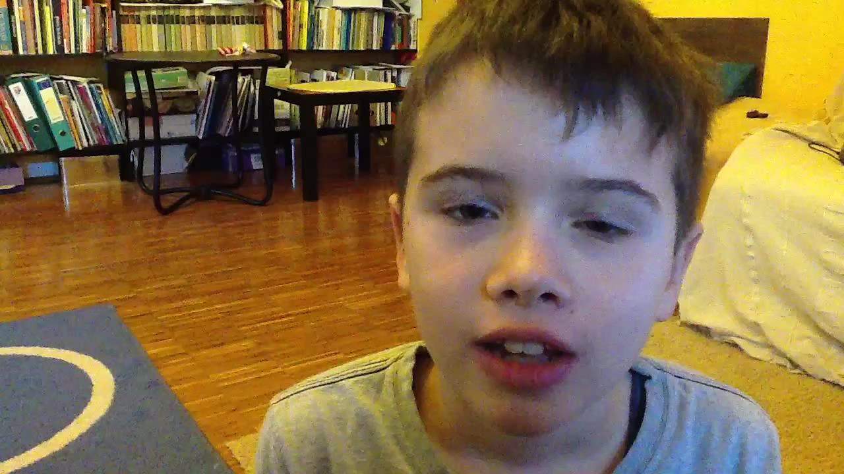

Slide 51

The Flow
Flow is the state reached when we are so immersed in an activity
that we cease to notice the passage of time
and have deep, effortless involvement .
Notes:
He described the state of flow. A state in which we stop to notice the passage of time and stop perceive the world around us.
How many of you have experienced this in your job?
We have to be thankful that our job is one of the few which put us in this state, because this is the state in which we experience the highest levels of happiness.

Slide 52
The Flow: tips
Activity should:
Require concentration (you'd better de-clutter first)
Be challenging (will stretch mind/body but still doable. No despair)
Have a learning curve
Be such that you can break it down into achievable goals that are:
Clear
Measurable
Bonus:
Flow is more likely to occur at work than in your free time.
Flow is rarely experienced in passive leisure activities.
Flow activities need an initial investment of effort before they start to become enjoyable.
Notes:
Challenging, Learning curve, break down.
Experienced in Work so go to work.
We are in the flow, because we did not notice that we are almost out of time
Controversial bits

Slide 53
Does happiness make me a better person?
Notes:
Being happy makes you a better person, right?

Slide 54
Can happiness be bad?
Notes:
Being happy makes you a better person, right?

Slide 55
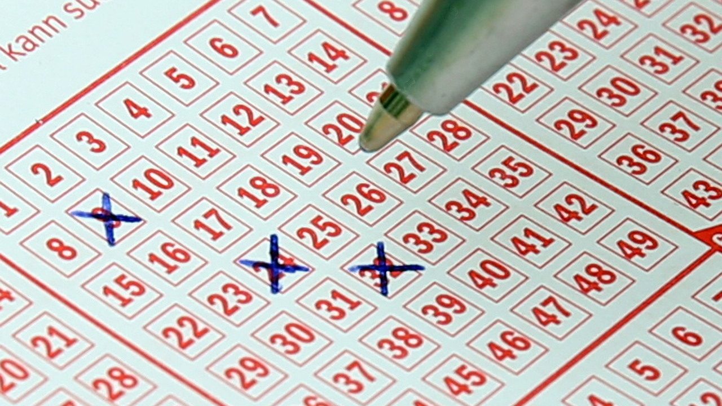
Notes:
Psychologist Joseph Forgas professor at New South Wales university Sydney. Participants were given lottery tickets, and then given a choice about how many tickets they wanted to give to others and how many they wished to keep for themselves. Those who were in a good mood ended up keeping more tickets for themselves. This suggests that, at least in some settings, being happy does not necessarily mean we will be generous. In fact, the opposite could be true.

Slide 56
Happiness can be exhausting
Notes:
If we focus too much on happiness it can make us less happy, especially if we do not measure it correctly or do not understand it properly.
Essentially, when happiness becomes a duty, it can make people feel worse.

Slide 57
Bulgaria ranked #105 happiest nation
Notes:
Back to our problem

Slide 58
The fix
Notes:
A lot of tips

Slide 59
Action
Freedom
Responsibility
Notes:
Happiness is something that cannot be found received or bought, it can only be built by ourselves. And it is is our responsibility to do so.
We are happy when we totally devote our time and focus to some activity.
And as long as this activity is aligned with your inner values you will be happy.
So, please, please, make that choice and be happy.

Slide 60
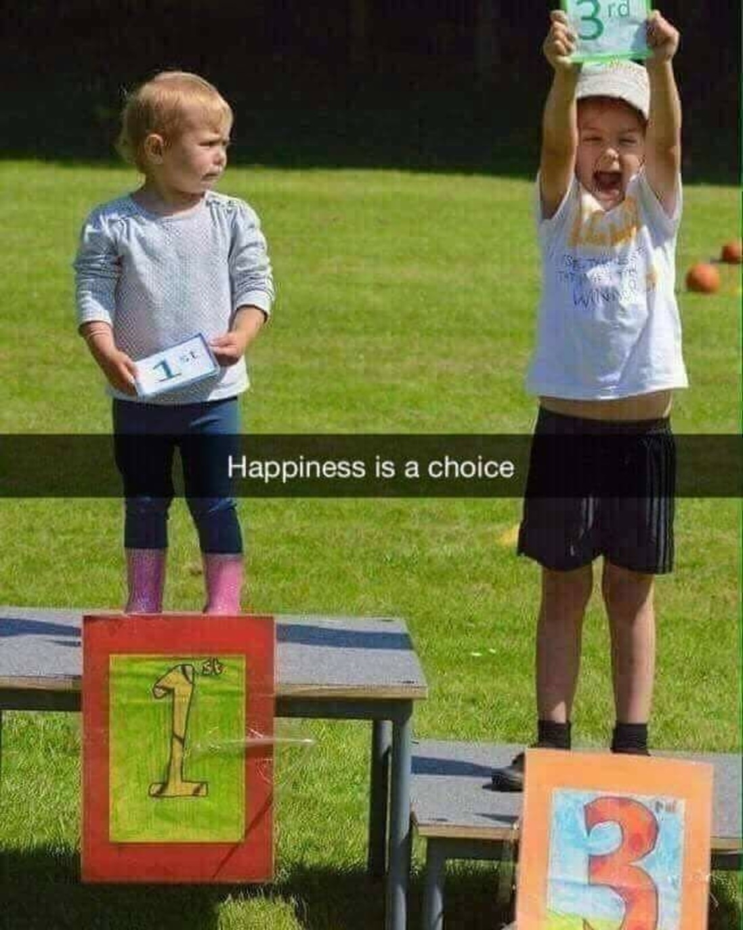
Notes:
And it is our choice whether we will build it for ourselves and people around us. Since there is no universal formula we should first understand what it means for us. Then we should build it. You want to be a better at work, then set a goal and spend 30 minutes a day to learn something new. Want to be a better human - do random act of goodness every day. Want to improve your work/life balance, reserve 1 hour per day for your friends and family. The most important thing to remember is that with no action there will be no results. If you want to make a change you should the time and the effort.

Slide 61
Thank You!
/Vlado, Rumen/

Slide 62


Slide 63
Stuff to watch / read
Daniel Wolpert: The real reason for brains | TED
Simon Sinek on millennials
Simon Sinek – why leaders eat last
What motivates gambling behavior? Insight into dopamine's role
Dopamine’s role in reward
Constitution of World Health Organization (definition of “health”)
How to increase serotonin in the human brain without drugs
Overcoming hopelessness | Nick Vujicic | TEDxNoviSad
Jordan B Peterson on 12 Rules for Life
The happy secret to better work
Dereflection – the problem when you focus too much on yourself (in German)
Can Seeking Happiness Make People Happy? Paradoxical Effects of Valuing Happiness
Career Satisfaction
Смисъл, мотивация, values (Bulgarian)

